Slide 1
Changes to Crop Insurance
Joe Outlaw
Professor and Extension Economist
Co-Director, AFPC
Texas A&M University
November 10, 2014
A major portion of this presentation is based on NCIS training materials

Slide 2
Crop Insurance had grown by five-fold

Slide 3
Current Rice Coverage Levels

Slide 4
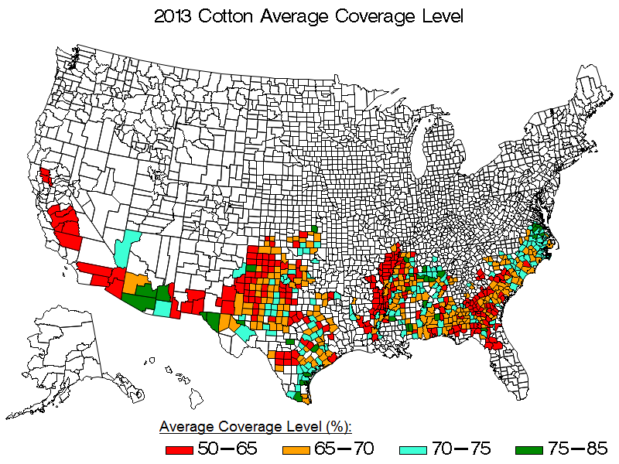
Current Cotton Coverage Levels

Slide 5
Current Corn Coverage Levels

Slide 6
Current Soybean Coverage Levels

Slide 7
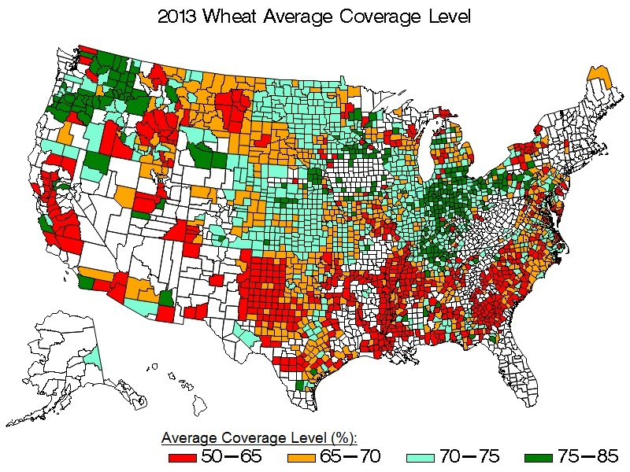
Current Wheat Coverage Levels

Slide 9
Title XI Crop Insurance
Creates two new shallow loss county triggered programs
Supplemental Coverage Option (SCO)
Stacked Income Protection Program (STAX) for cotton
Conservation Compliance for crop insurance

Slide 10
Major Crop Insurance Changes
Traditional crop insurance changes
Separate coverage level by practice
Enterprise units by dryland/irrigated practice
Beginning farmers (provides 10 percentage point discount for all crop insurance premiums)
Authority to do peanut revenue insurance
Establishes fund to combat crop insurance fraud
Crop margin coverage & peanut revenue coverage

Slide 11
Separate Coverage Level by Practice
If the crop provisions allow the option to separately insure individual crop types or varieties, and the actuarial documents provide for separate coverage
If insured has additional (buy-up) coverage
May select one coverage level for all irrigated acreage in the county and one coverage level for all non-irrigated acreage in the county
Ex. 65% coverage for all Irr Corn and 80% coverage for all Non-Irr Corn
Even if have a High Risk (HRLE) Cat policy in addition to Irr and Non-Irr
One administrative fee

Slide 12
Separate Coverage Level by Practice
Separate coverage by practice cannot break out specific practices within each
EX. 65% level for Irr Soybeans acreage (consisting of both Conventional and Certified Organic) and 80% level for Non-Irr Soybeans (consisting of Conventional and Transitional Organic)
Some Crop Provisions allow different coverage levels by crop type or variety
EX. Dry peas and Apples

Slide 13
Separate Coverage Level by Practice
Dry Pea Type | Practice(s) | Coverage Level
Spr Large Kabuli | Irr Organic (Cert) Irr Organic (Trans) Irr | 65%
 | Non-Irr Organic (Cert) Non-Irr Organic (Trans) Non-Irr | 75%
Spr Small Kabuli Chickpeas | Irr Organic (Cert) Irr Organic (Trans) Irr | 60%
 | Non-Irr Organic (Cert) Non-Irr Organic (Trans) Non-Irr | 70%

Slide 14
Separate Coverage Level by Practice
Apple Type | Practice(s) | Coverage Level
Processing | Irr | 65%
Processing | Non-Irr | 70%
Fresh Type | Irr | 70%
Fresh Type | Non-Irr | 75%

Slide 15
Enterprise Units by Practice
If allowed by the actuarial documents and crop provisions
Must separately meet the requirements for each enterprise unit
Only available for on additional coverage policies for crops:
For which revenue protection is available regardless of whether YP or RP is elected
For which RP is not available if authorized by special provisions
If show as an authorized unit structure in the actuarial documents

Slide 16
Enterprise Units by Practice
Each Irr/Non-Irr EU must meet existing EU requirements:
Planted acres of at least 20 acres or 20% of insured crop acreage in 2+ legal descriptions or units (can aggregate if needed)
Sections, section equivalents &/or Farm Numbers (used as the basis for optional units)
Units as established by WUA (written unit agreement) or UDO (unit division option) or
At least 660 planted acres in one section/section equivalent/ Farm Number (basis for optional units)
Must plant crop with a clear & discernable break in the planting pattern at Irr/Non-Irr boundaries to qualify for separate EUs

Slide 17
Enterprise Units by Practice
Question: Am I allowed to have EU for my Irr acreage and basic or optional unit on my Non-Irr acreage
Answer: No, you may only elect to have separate EU for both your Irr and Non-Irr acreage and each must independently qualify as an EU
Question: If I do not qualify for separate EU on Irr and Non-Irr acres, can I still have one EU?
Answer: Yes but …

Slide 18
Title XI Crop Insurance
Adjustment in APH insurable yields
Producer may opt to exclude any year from APH if yield in county in that year is less than 50% of ten-year county average; Also applies to contiguous counties and allows for the separation of irrigated and non-irrigated acres
Studies or policies are also required on insuring:
Specialty crop producers for food safety and contamination-related losses,
Swine producers for a catastrophic disease event,
Producers of catfish against reduction in the margin between the market prices and production costs,
Commercial poultry production against business disruptions caused by integrator bankruptcy,
poultry producers for a catastrophic event,
Producers of biomass sorghum or sweet sorghum grown as feedstock for renewable energy,
Alfalfa crop insurance.
Whole farm diversified risk management insurance plan

Slide 19
Supplemental Coverage Option (SCO)
RMA delivered beginning in 2015.
65% premium subsidy.
No payment limit.
Top coverage of 86% coverage
County-level optional endorsement for crop insurance policies.
“Tops up” crop insurance to cover deductible.
Yield or revenue triggered depending on underlying crop insurance policy.
Expected county yield = GRP trend yield. Expected revenue = GRP trend yield x crop insurance base price.
Actual county yield = County yield. Actual revenue = county yield x crop insurance harvest price.
Coverage ceases at coverage level for underlying insurance policy.
May purchase STAX and SCO, but not on same acres.
Must purchase underlying insurance policy

Slide 20
Supplemental Coverage Option (SCO)
Question: If SCO/STAX is purchased with a CAT underlying/companion policy, what amount will the producer be charged?
Answer: The producer will be charged a $300 admin fee for the underlying/companion policy, a $30 admin fee for SCO/STAX, and the producer portion of the total SCO/STAX premium
Note: SCO is always considered buy-up coverage, even when paired with an underlying policy purchased at the CAT level

Slide 25
SCO Worksheet
Row | Calculation/value | 1 | 2 | 4 | 5
1 | Projected price (1/15-2/14 average for Dec corn contract) | $3.92 | $3.92 | $3.92 | $3.92
2 | APH yield | 160 | 160 | 160 | 160
3 | Crop insurance coverage level | 70% | 70% | 70% | 70%
4 | Expected farm revenue (Row 1 x Row 2) | $627.20 | $627.20 | $627.20 | $627.20
5 | SCO coverage (86% − Row 3) × Row 4 | $100.35 | $100.35 | $100.35 | $100.35
6 | Expected area-wide yield (bu.)per planted acre (higher of trend yield or 5-year moving average) | 140.0 | 140.0 | 140.0 | 140.0
7 | Area-wide projected income (Row 1 × Row 6) | $548.80 | $548.80 | $548.80 | $548.80
8 | SCO coverage level | 0.86 | 0.86 | 0.86 | 0.86
9 | November average of December corn futures price | $3.40 | $3.40 | $3.40 | $3.40
10 | Actual area-wide yield per planted acre (bu.) | 140.0 | 130.0 | 110.0 | 100.0
11 | Area-wide realized income (Row 9 × Row 10) | $476.00 | $442.00 | $374.00 | $340.00
12 | Revenue ÷ expected revenue (Row 11 ÷ Row 7) | 87% | 81% | 68% | 62%
13 | Percent shortfall as a percent of deductible % [Row 13 ÷ (Row 8 − Row 3) Bounded at 100%] | 0% | 34% | 100% | 100%
14 | Indemnity (Row 5 × Row 14) | $0.00 | $34.25 | $100.35 | $100.35

Slide 26
Crop Insurance Choices
Coverage Level | Basic & Optional Subsidy % | Enterprise Unit Subsidy % | SCO Subsidy | STAX Subsidy %
50% | 67% | 80% | 65% | 80%
55% | 64% | 80% | 65% | 80%
60% | 64% | 80% | 65% | 80%
65% | 59% | 80% | 65% | 80%
70% | 59% | 80% | 65% | 80%
75% | 55% | 77% | 65% | 80%
80% | 48% | 68% | 65% | 80%
85% | 38% | 53% | 65% | 80%

Slide 27
Final Thoughts
Crop risk management portfolio
Commodity programs
Crop Insurance
Input cost
Finances
Learn about crop insurance
Ask about enterprise units and SCO

