Slide 1
Preparation for Using NAAFP Decision Aid
Information needed for the Decision Aid are available from two primary sources
FSA Reported Commodity Crop History Summary (letter from FSA to producers, August 2014)
FSA farm number
Base Acres and CCP Yield for covered crops
Planted Acres
Crop Insurance Actual Production Report
Historical yields and planted acres
Ten years of yields preferred but 2008-2013 is essential

Slide 2
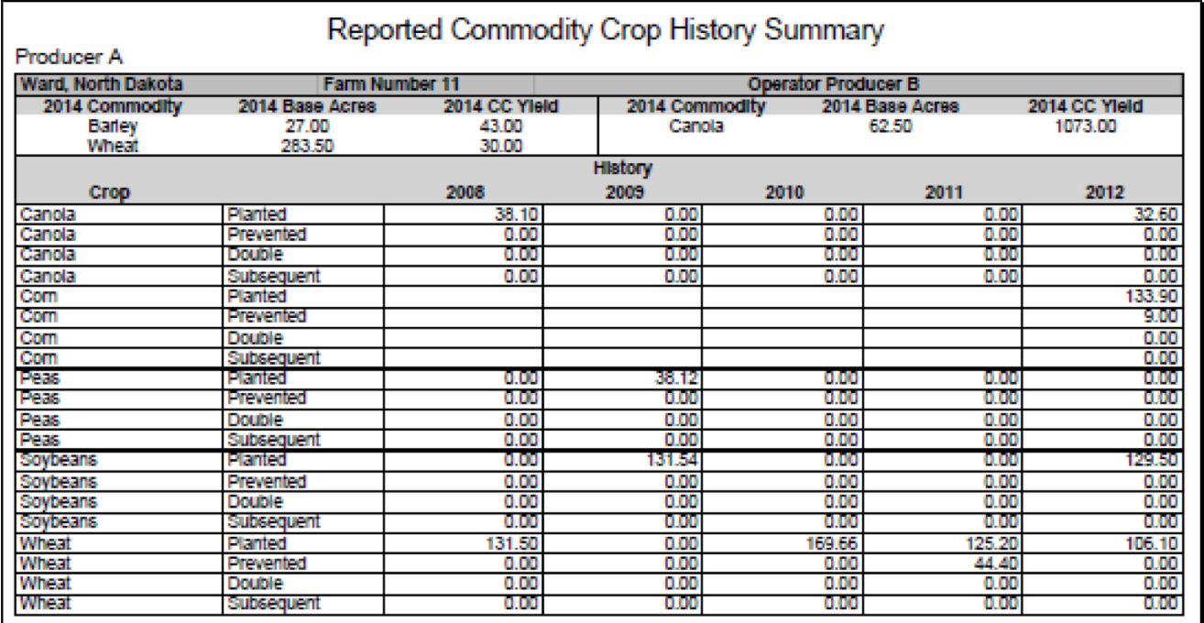
FSA Crop History Summary

Slide 3
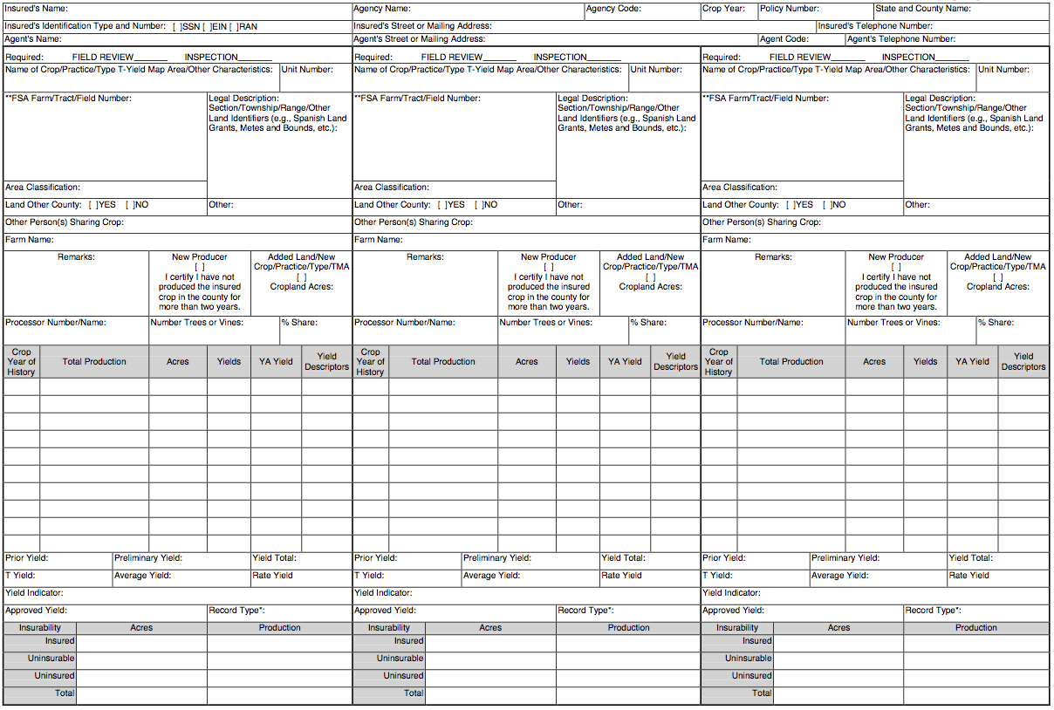
Insurance Yield & Acreage Report

Slide 4
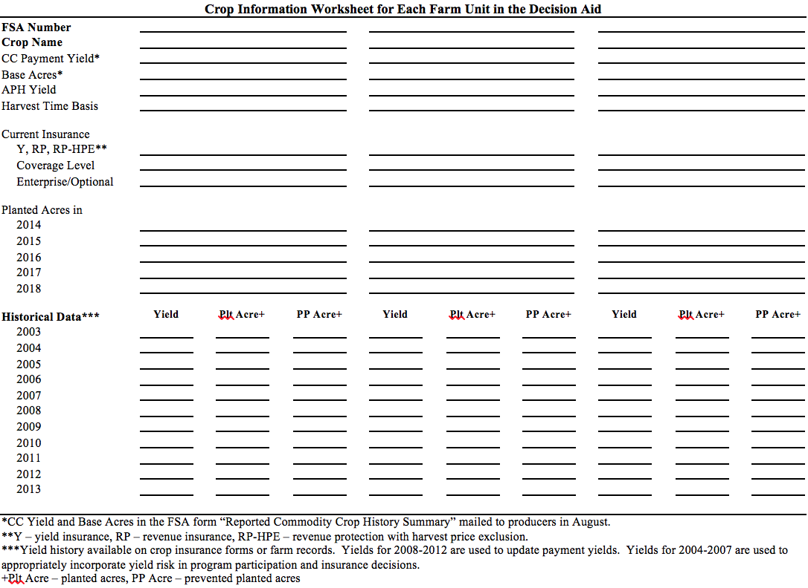
NAAFP Crop/Unit Information Sheet

Slide 5
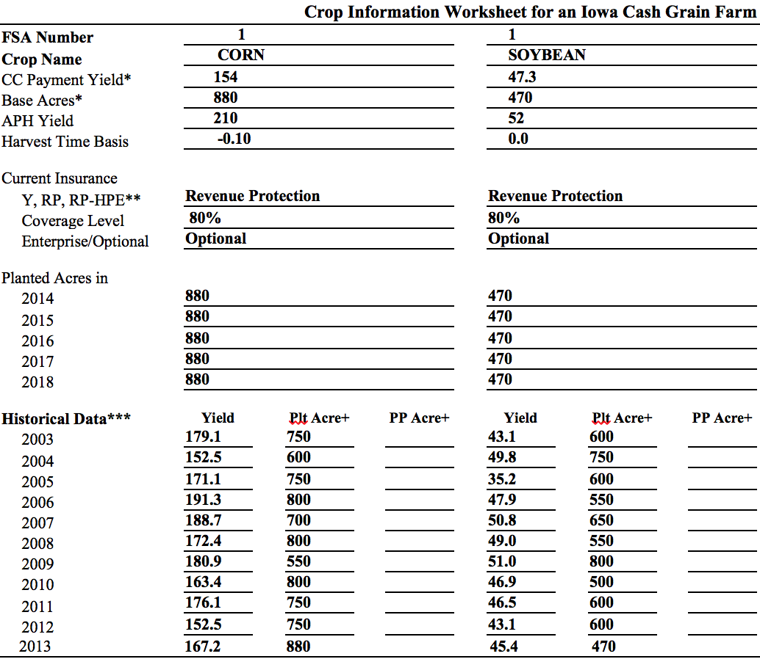
NAAFP Information Sheet Ex. Iowa Farm
Historical Data needed for risk analysis
Data needed for risk analysis, yield update, and base reallocation

Slide 6
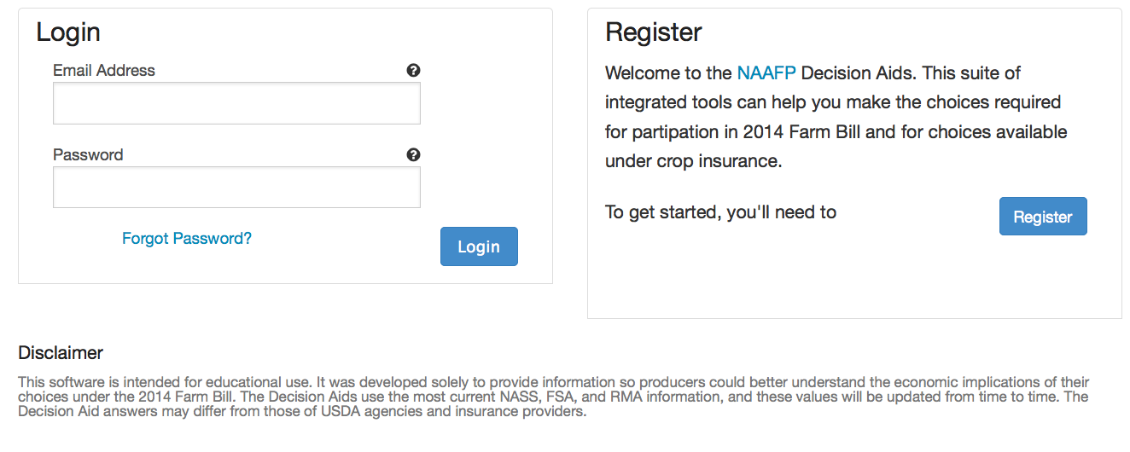
First Step Is to Register

Slide 7
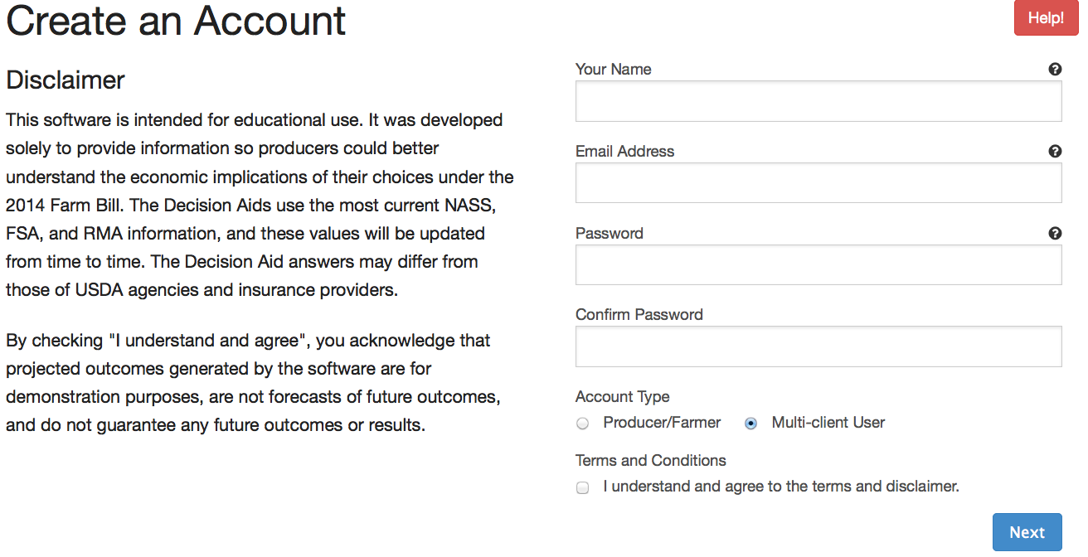
Producer data is Saved, Email to Notify Regarding FSA Updates

Slide 8
Producer and Multi Client Users

Slide 9
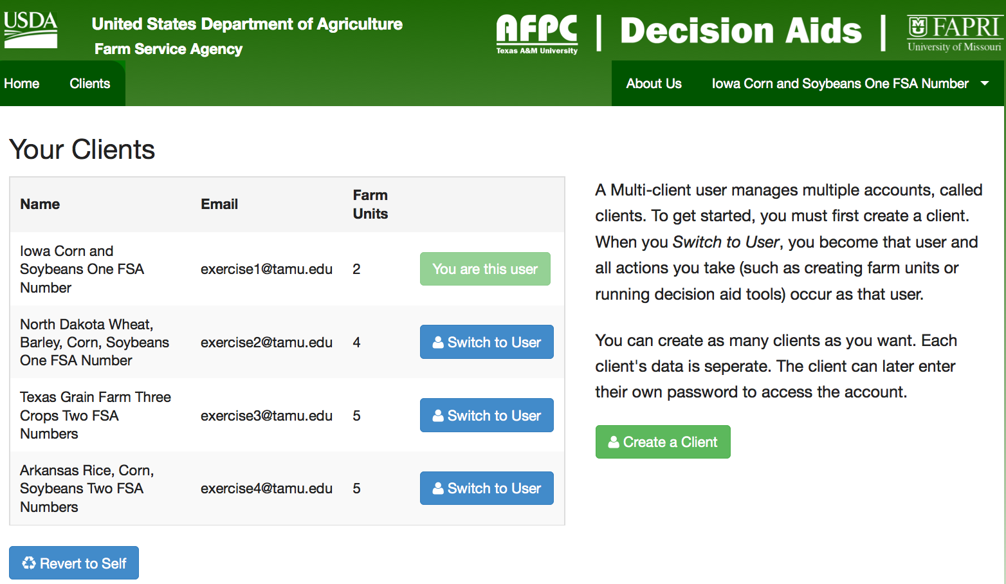
Create Client Records & Switch Clients

Slide 10
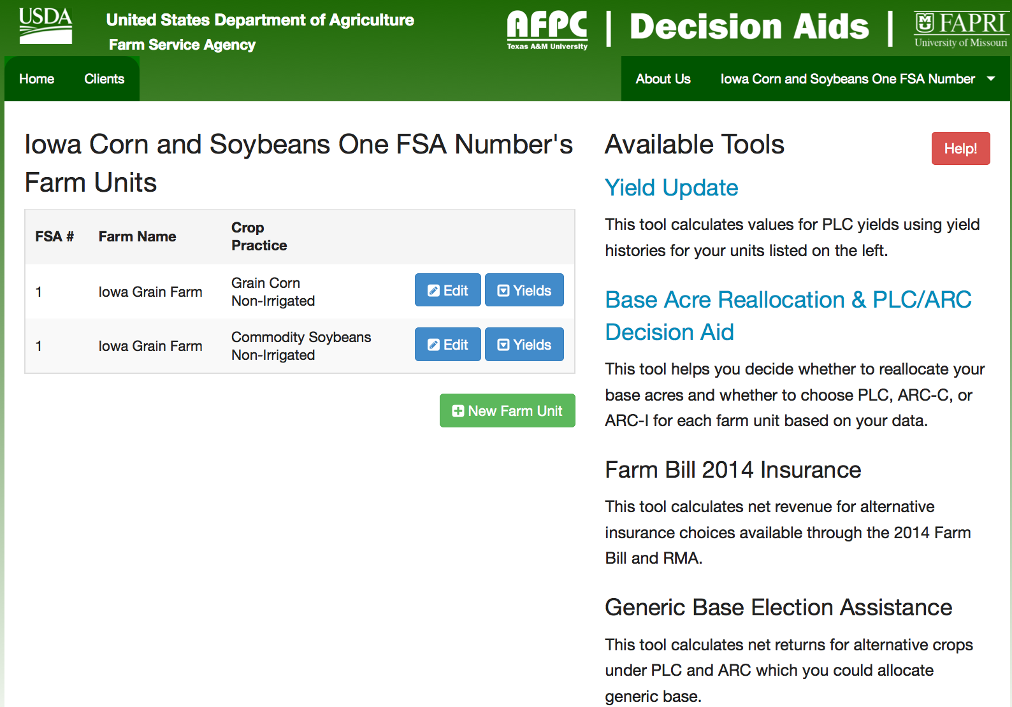
Farm with Two Crops and One FSA Number

Slide 11
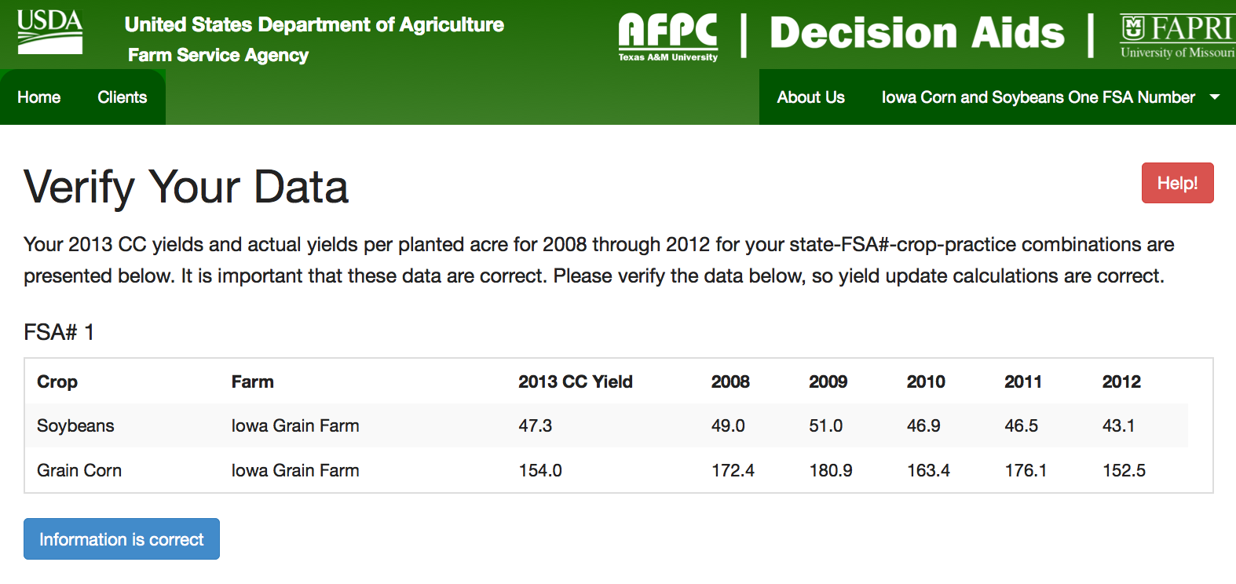
Yield Update Analyzer

Slide 12
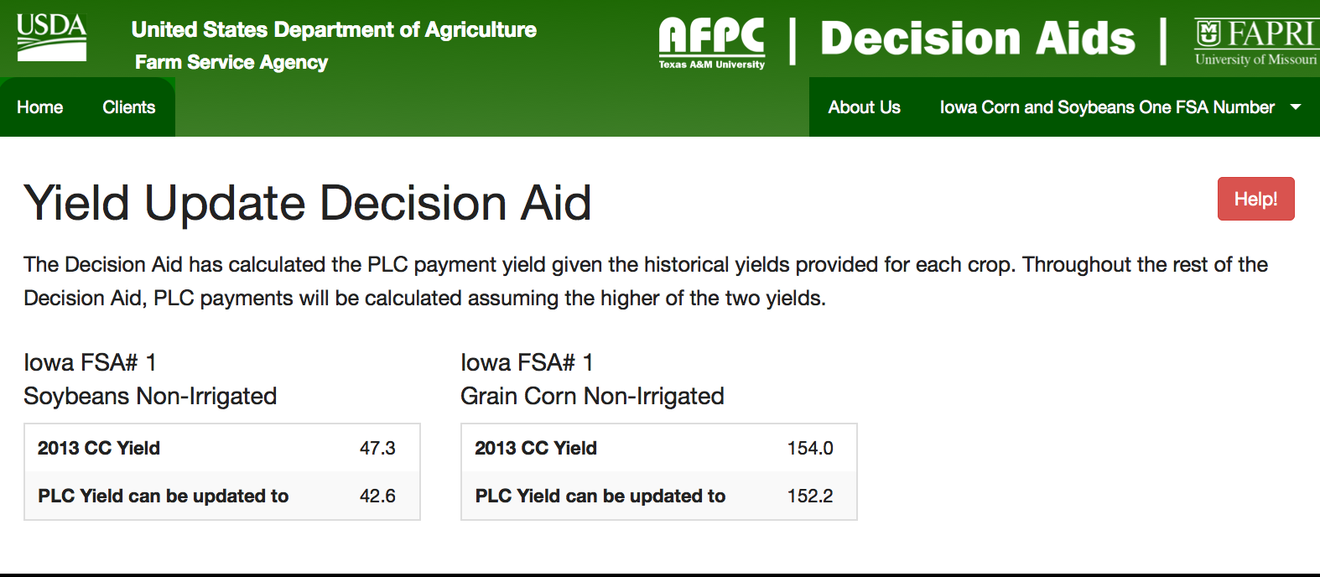
Results for Yield Update
Producer can print the FSA Yield Worksheet
Print a separate form for each FSA number. Fill in the name and email address for contact person, farm number, historical yields, state code, and county code.

Slide 13
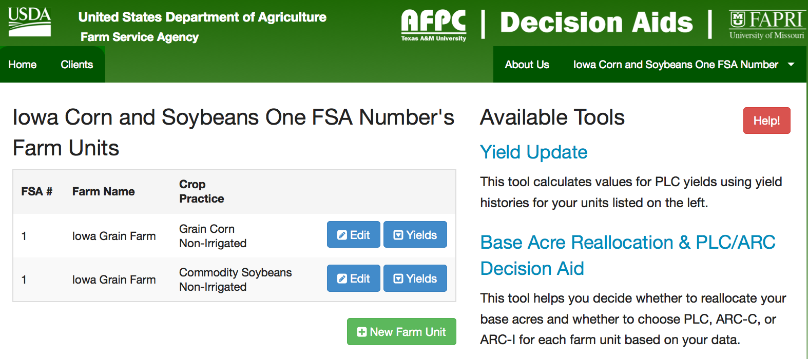
Select the Base Acre Reallocation & PLC/ ARC Decision Aid

Slide 14
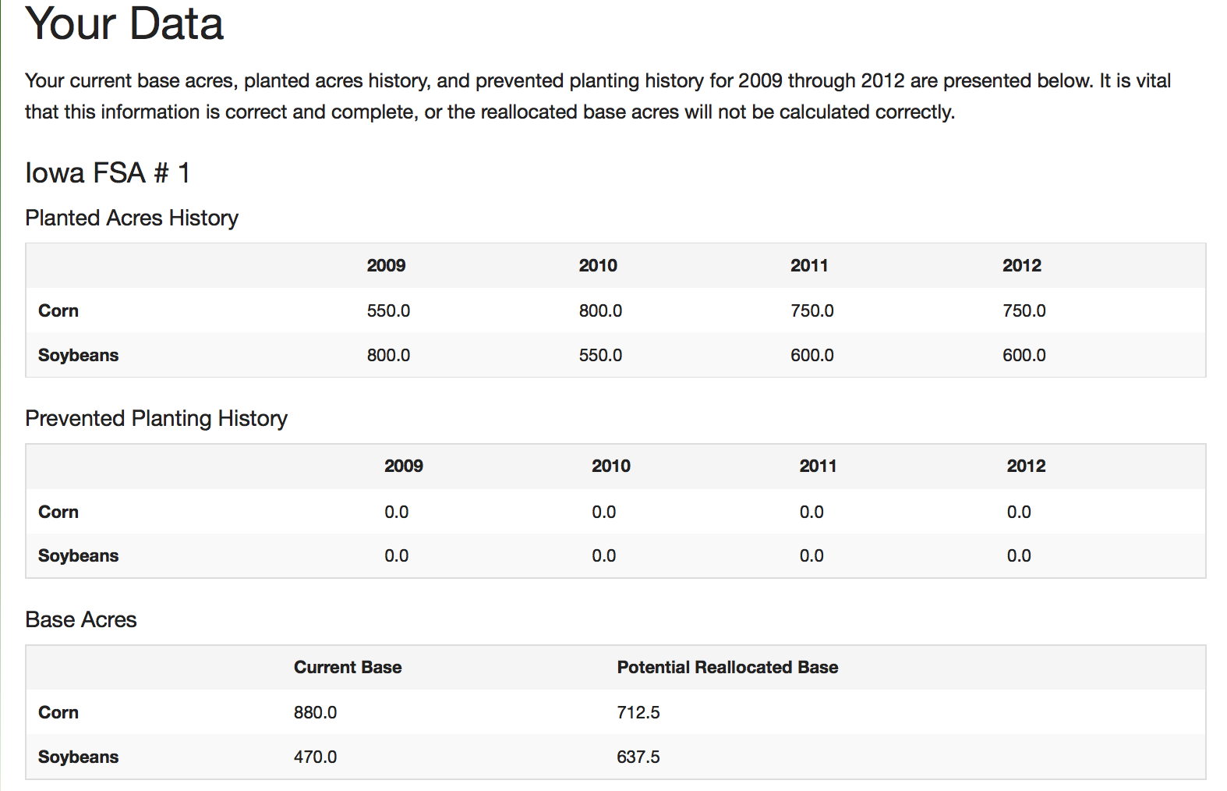
Base Reallocation Options Calculated Directly, Next Analyze their Impacts on Payments by Program

Slide 15
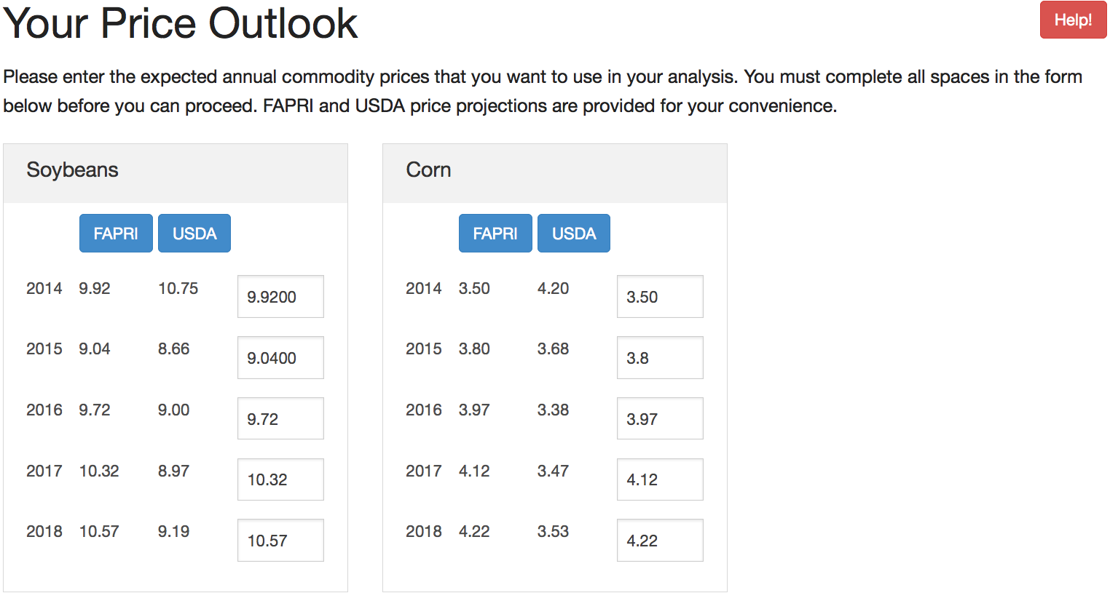
Three Choices for Testing Alternative Price Scenarios

Slide 16
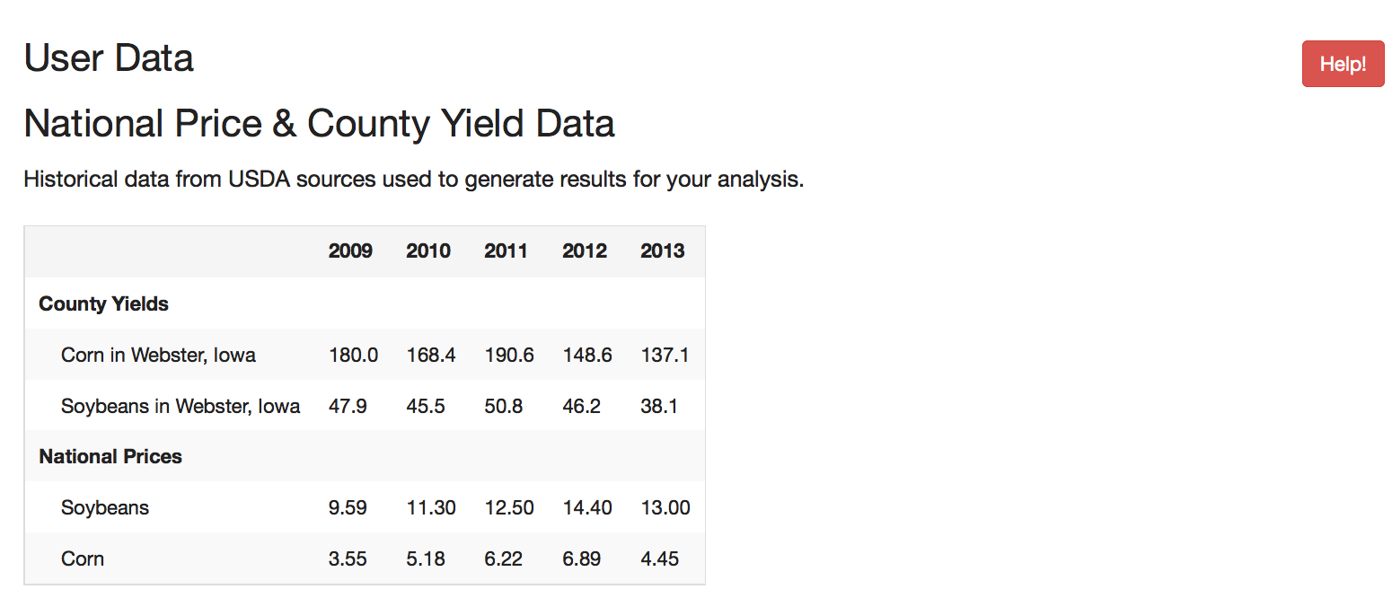
Output for Base Reallocation, PLC, ARC-IC, and ARC-CO

Slide 17
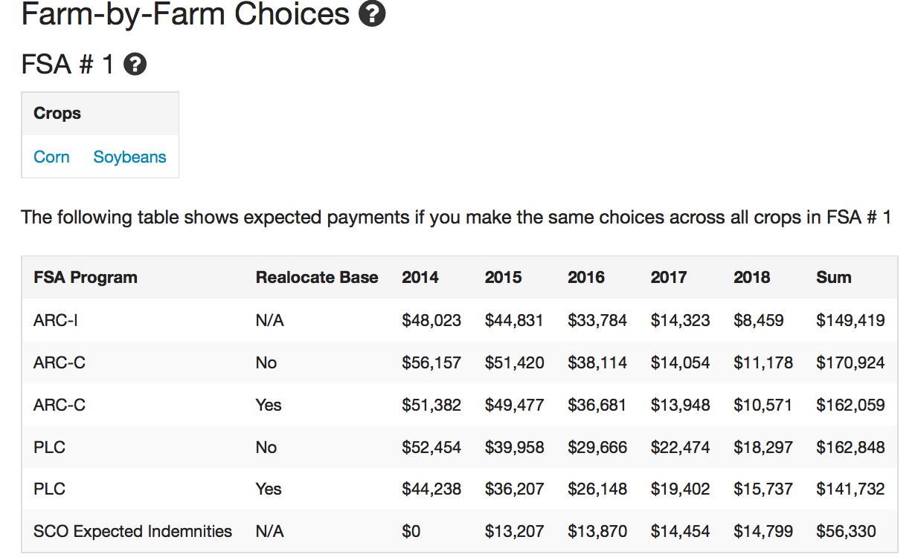
Whole Farm Decision: All Crops Elect the Same Program

Slide 18
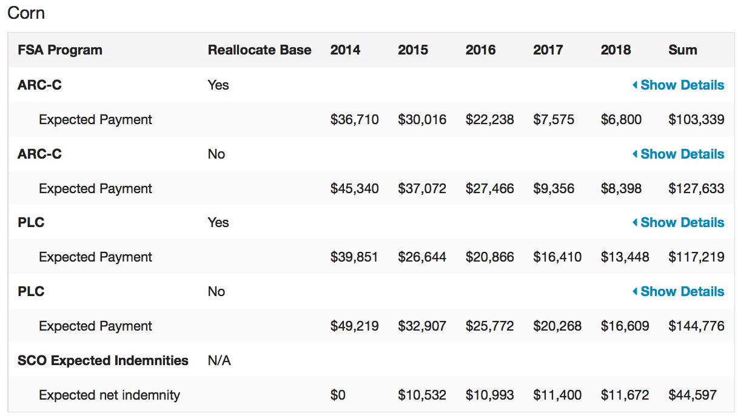
Crop-by-Crop Results for Each Program Election Option

Slide 19
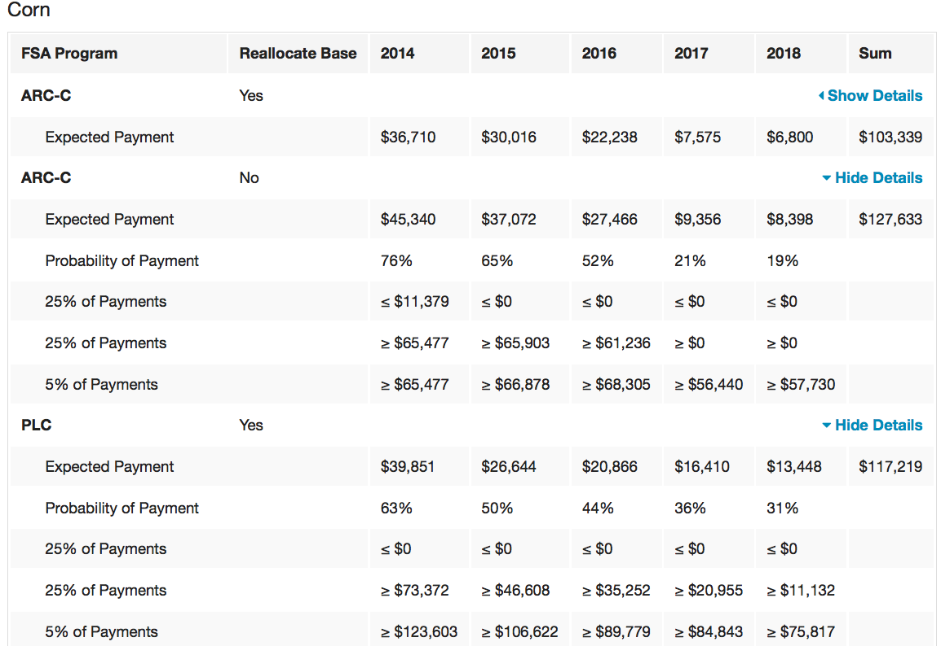
Unfold Details to See Risk of Payments for PLC and ARC

Slide 20
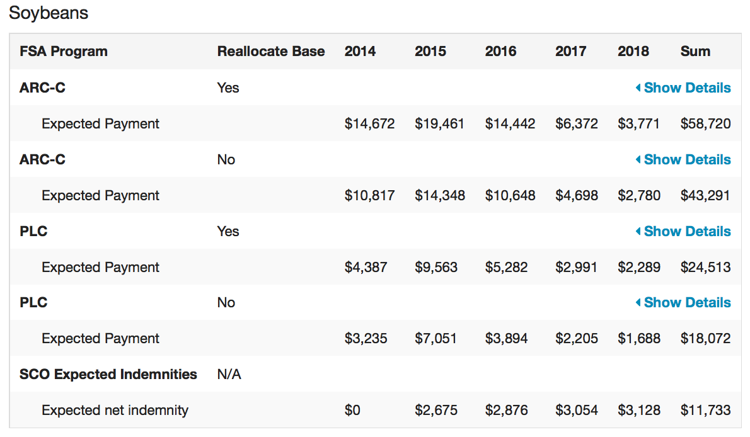
Crop-by-Crop Results for Each Program Election Option

Slide 21
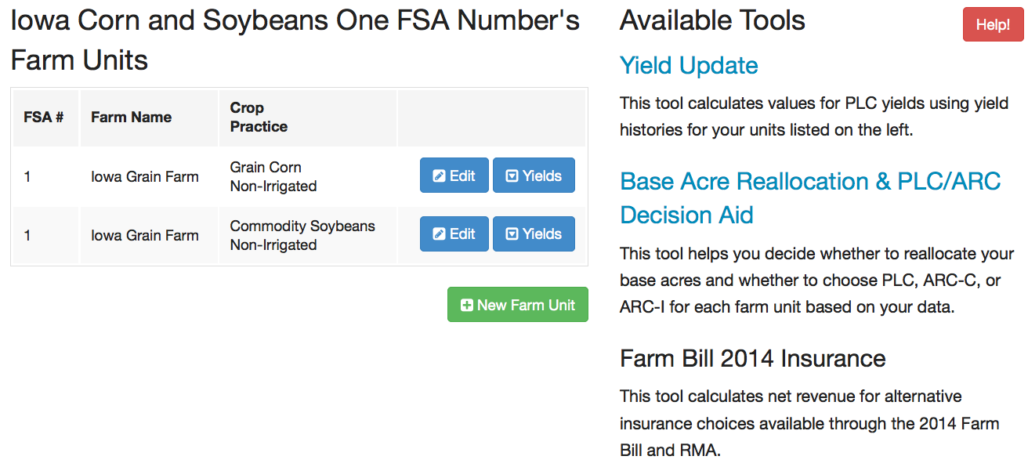
Crop Insurance Analysis Interacts with ARC/PLC+SCO

Slide 22
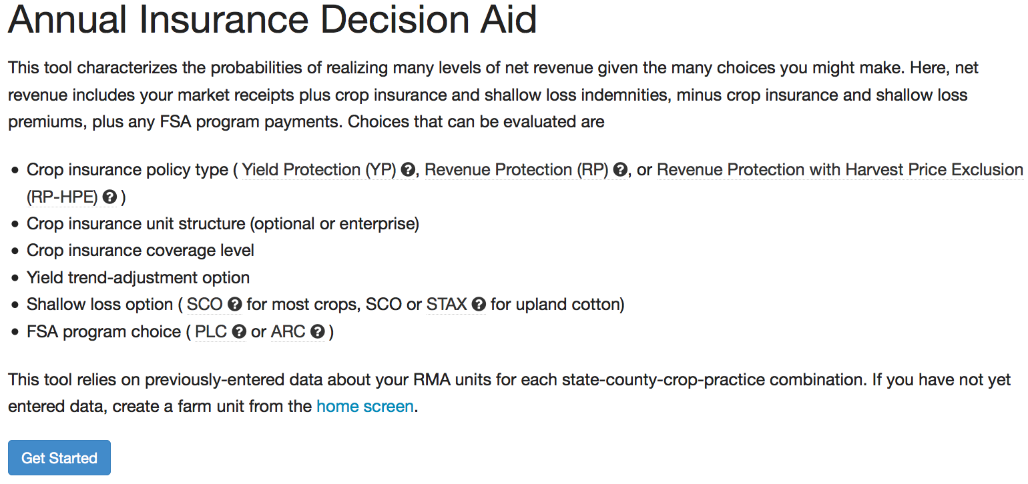
Crop Insurance Analysis Interacts with ARC/PLC+SCO

Slide 23
Crop Insurance Analysis Interacts with ARC/PLC+SCO

Slide 24
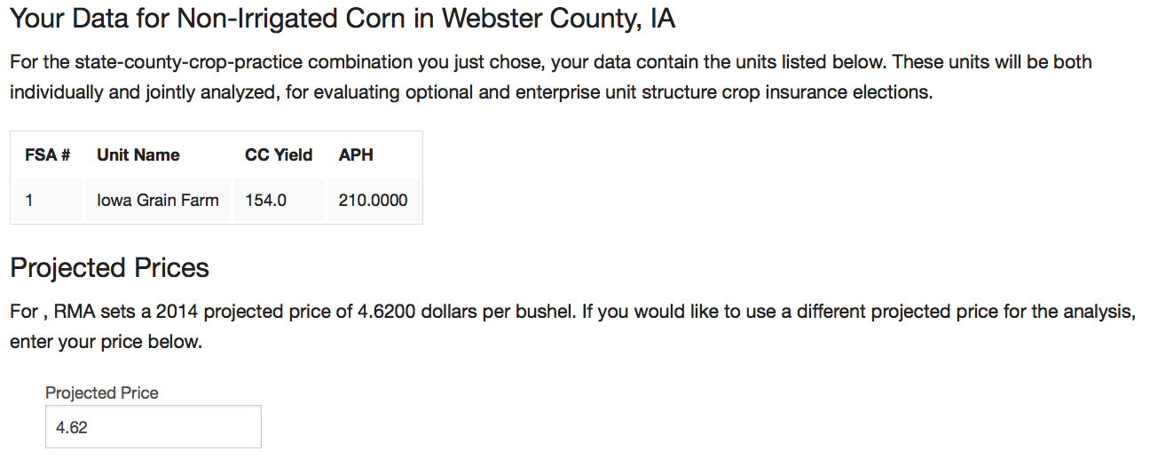
Crop Insurance Analysis Interacts with ARC/PLC+SCO

Slide 25
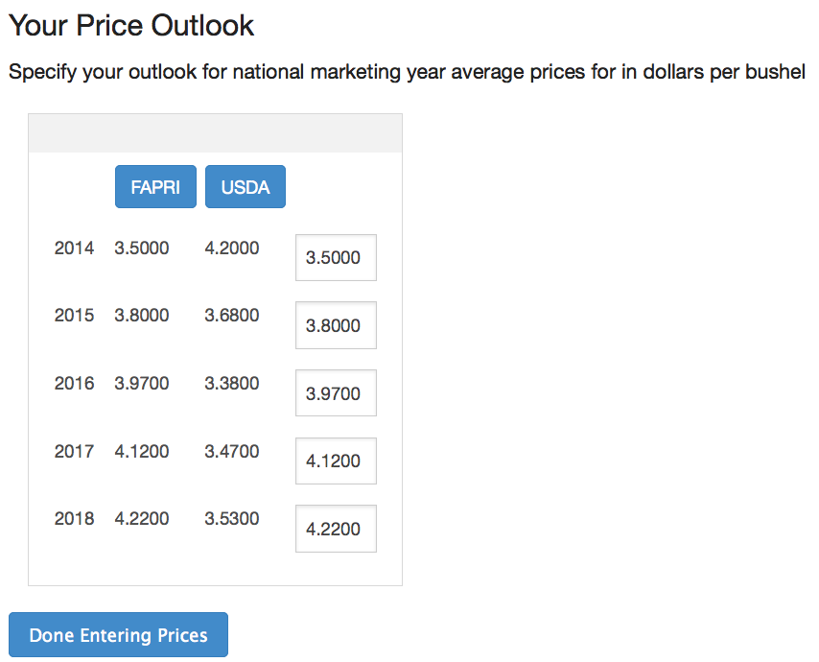
Crop Insurance Analysis Interacts with ARC/PLC+SCO

Slide 26
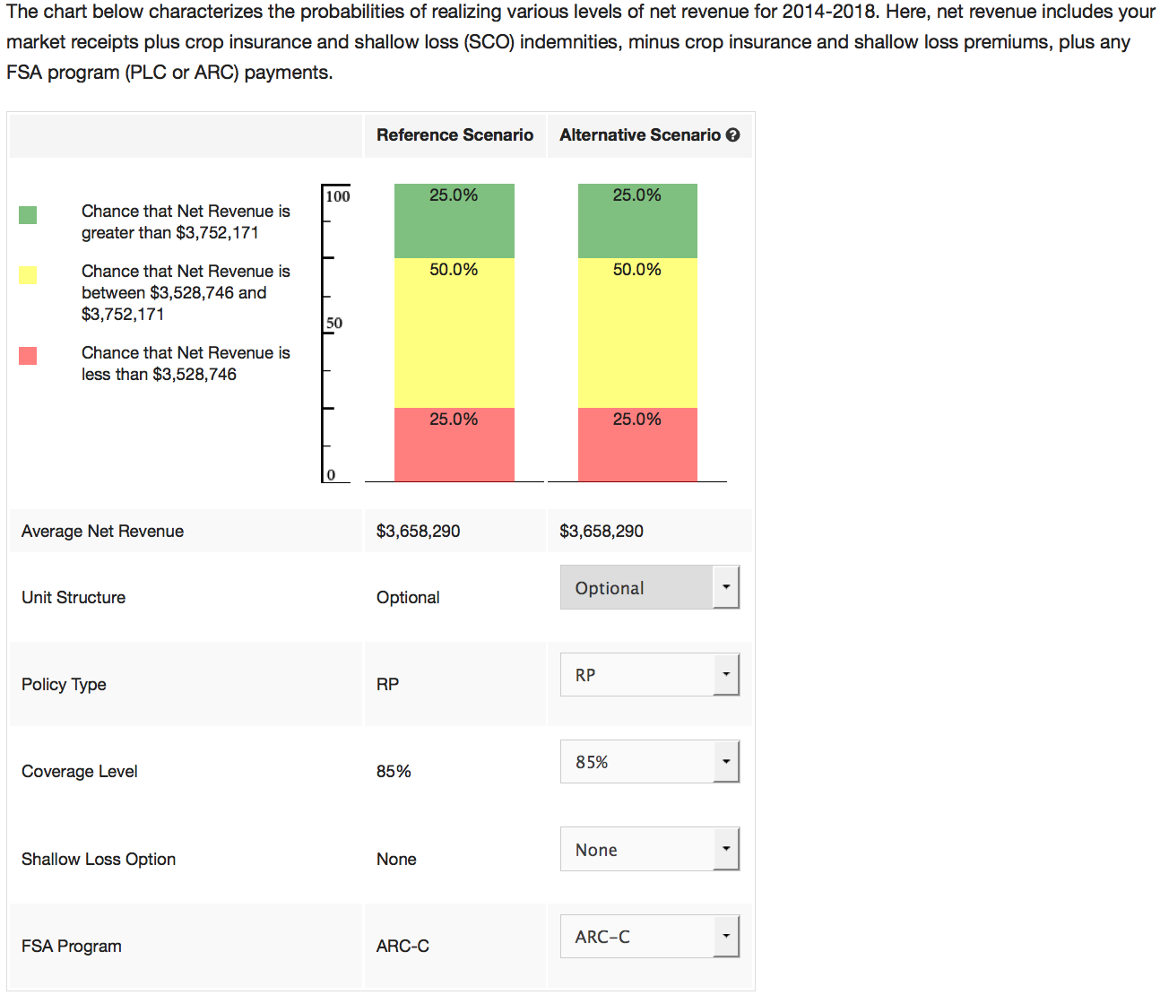
Crop Insurance Analysis Interacts with ARC/PLC+SCO
Net revenue for the “best” combination of ARC/PLC and Insurance is presented.
Result here is ARC, with Revenue Protection at 85%.

Slide 27
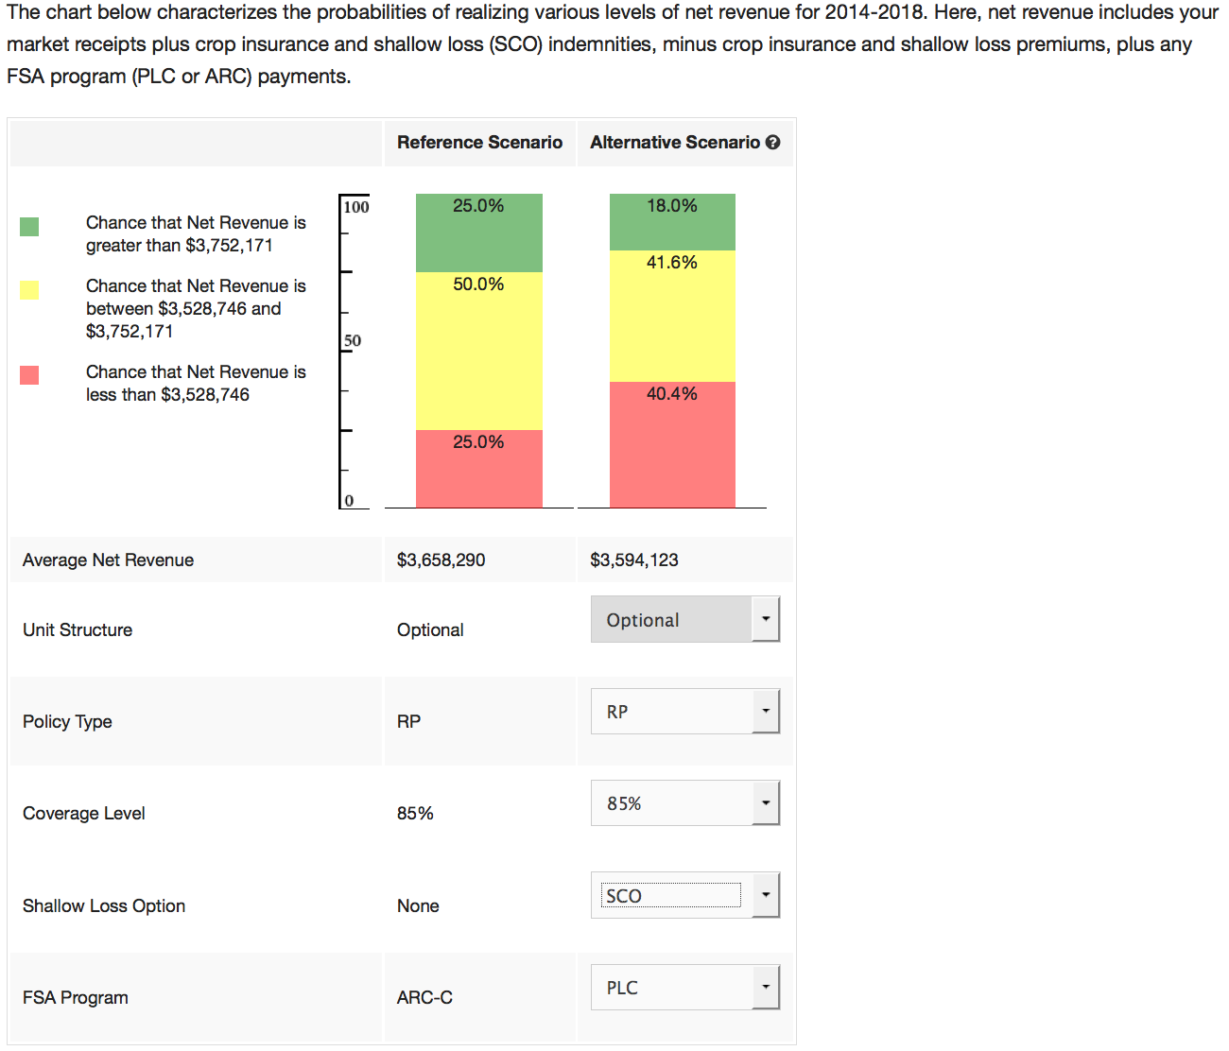
Crop Insurance Analysis Interacts with ARC/PLC+SCO
Option buttons allow user to test impact of program and insurance changes.
In this case PLC plus SCO rather than ARC reduces net revenue (40.4% chance of net revenue below lower target).

Slide 28
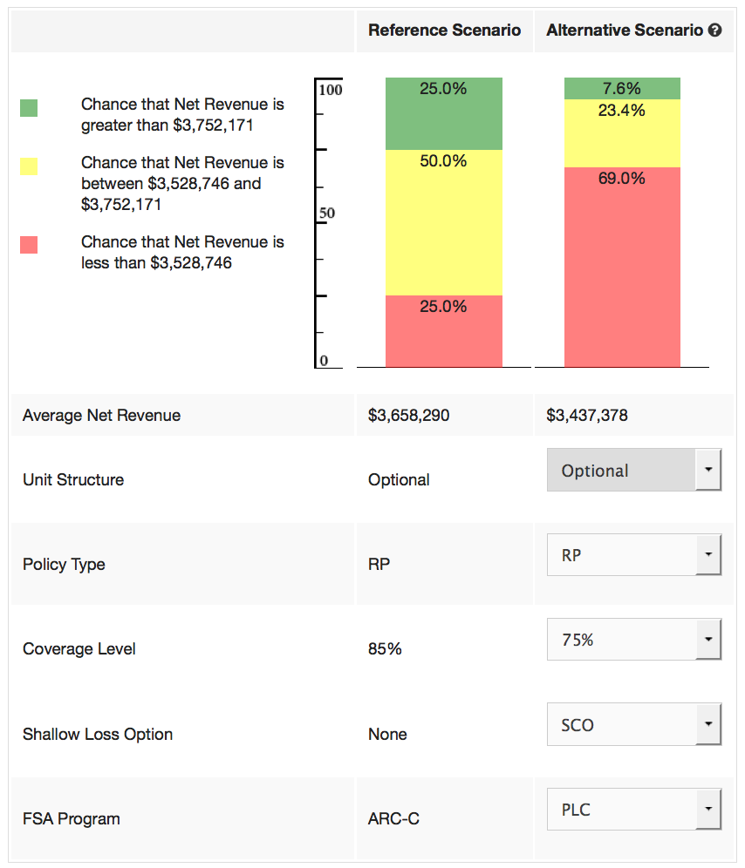
Crop Insurance Analysis Interacts with ARC/PLC+SCO
Option buttons allow user to test impact of program and insurance changes.
In this case PLC plus SCO and a lower level of underlying insurance coverage for RP to 75% rather than choosing ARC with 85% coverage reduces net revenue (69% chance of net revenue below lower target).

Slide 29
Future Developments
Farmers will be able to print FSA forms
Yield update information form
Base acre reallocation form
ARC/PLC election form
Print a separate form for each FSA number with:
Name and email address for contact person
Farm number
Historical yields and planted acres
State and county codes
AND the ARC/PLC election by crop by farm
We are still testing and improving
More than 2,000 farmers, FSA, extension, and insurance agents testing the decision aid

Slide 30
Summary
Decision Aid available on AFPC website since June 20th
More than 2,000 testers
Will be on FSA website when officially released
All 21 covered commodities plus cotton available in the official release version
Changes we expect after the official release:
Monthly updates of price projections by FAPRI
USDA price projections updates as available
Tool will be updated as FSA updates rules
Accessible by smart phones, tablets, iPads, anything that can access the internet
Helpdesk available 7am to 7pm CST

