Slide 1
Wheat Marketing and Risk Management Wheatheart Wheat Conference Perryton, Texas August 13, 2009 Mark Welch Grain Marketing Economist
Hang on
or
let go?

Slide 2
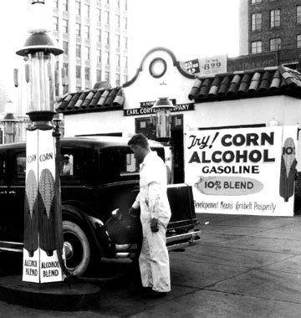
Market Drivers
FEAR
Economy
Demand
Exports
Feed
Food
Supply
Export Competition
Planted Acres
Weather
Flat
Adequate
Pumping ethanol from corn in 1933
“Without the runaway demand growth of ethanol, many of the recent stories need to be rewritten in short order.”
--Michael Swanson, Economics Department, Wells Fargo
Notes:
Ethanol and crops for fuel are the policy actions behind current situation. Drought and production problems, growing incomes in China and India changing diets (increased consumption of meat and dairy), cheap dollar, price of oil, speculator investment are others.
IFPRI study: corn prices are up by 40% because of ethanol. Wheat prices are 22% higher than they would be without ethanol policy.
May trade fundamentals again when financial markets settle down.

Slide 3
Value of Wheat in a Loaf of Bread
1980 2009
$0.51 Average Price of a Loaf of Bread $1.40
$4.25 Average Price of Wheat $6.63
$0.06 Value of Wheat in a Loaf of Bread $0.09
$0.46 Value of Other Factors in a Loaf of Bread $1.31
11% Value of Wheat in a Loaf of Bread, % 6%
Avg U.S., white bread, 1-lb loaf KC HRW, Ordinary Protein

Slide 4
Global Economic Growth
Global economic growth is being driven by developing nations.
Real GDP Growth, 1980 - 2014
As of April 2009
Source: http://www.imf.org/external/datamapper/index.php; 2009-2014 projections

Slide 5
World Per Capita Grain Use
kg
corn, barley, sorghum, rye, oats, millet, mixed grains, wheat, rice
7/10/09
Notes:
Red areas show times of world wide economic slowdown. Grain use can go down in a recession. Currently about 2 pounds per person per day. Ethanol mandates may hold grain demand strong in current economic slowdown even with crude oil demand on the decrease.

Slide 6
World Per Capita Consumption
Kg
Yr to Yr 11-yr
+16%
-3%
-0%
+29%
Updated 7/10/09

Slide 7
Annual World Per Capita Wheat Production and Consumption
Kg/person
July 10, 2009, USDA, PS&D database
Notes:
Trend in per capita consumption is flat at best

Slide 8
World Wheat: Days of Use on Hand
8/12/09
Notes:
Almost back to normal

Slide 9
U.S. Wheat Supply and Demand, 8/12/09
+0 +72 -5 = +5 +25 +37

Slide 10
U.S. Wheat Use
Source: USDA/ERS, WASDE, USDA , 2009/10 estimated
Updated 8/12/2009
Notes:
Most use categories are flat

Slide 11
U.S. Wheat Stocks
000 bu
Notes:
Stocks above the last two years and the five year average

Slide 12
U.S. All Wheat Exports, MY to Date
Notes:
Growth in exports is important to sustain prices at current levels. Year to date level exceeds last year by 52%. Current marketing year projection exceeds 2006/07 by 32% (1275 to 909)

Slide 13
Major High Quality Wheat Competitors Production and Exports
000 mt 000 mt
Notes:
Lower export competition in 2009/10 from Canada and Argentina

Slide 14
Euros per $US
€
Notes:
What are the implications of this chart for a person travelling from the U.S. to Europe? From Europe to the U.S.

Slide 15
Wheat Prices
$ or €
Notes:
In early 2001, wheat cost more in euros than dollars due to strong dollar. Exchange rate was 1:1 in late 2002. Now wheat is considerable cheaper in euros than dollars.
Decline since February: -20% in dollars, -22% in euros

Slide 16
ENSO Alert System Status: El Niño Advisory
Synopsis: El Niño conditions will continue to develop and are expected to last through the Northern Hemisphere Winter 2009-2010.
During June 2009, conditions across the equatorial Pacific Ocean transitioned from ENSO-neutral to El Niño conditions. Sea surface temperature (SST) anomalies continued to increase, with the latest
weekly departures exceeding +1.0°C along a narrow band in the eastern equatorial Pacific (Fig. 1). All of the weekly SST indices increased steadily during June and now range from +0.6°C to +0.9°C (Fig. 2).

Slide 17
JFM Precipitation Anomalies (mm) and Frequency (%)

Slide 18
Northern High Plains Dryland Wheat Yields
Average = 21 bu/ac
El Nino Average = 23 bu/ac
Strong El Nino Average = 30 bu/ac
Notes:
Weak means the ONI value never got above 0.8 and the event ended in March or February. Strong means the ONI was over 2.0 or it lasted more than a year.
Usually means less precip in Eastern Australia and more in Argentina, but maybe too late to help the wheat crop.
40 year average is 30 bushels. Average for El Nino years = 31.4

Slide 19
Wheat Variable Costs and Grain Revenue
$/acre
Good yields Good price
2010 crop: 20 bushel yield, $5.45 BE (about $6.10 on the board)

Slide 20
Grazing Rate to Break Even with Grain Production
$ per pound of gain
Wheat per Bushel
Grazing = 5 bushel yield loss and +$4/acre costs

Slide 21
Seasonal Price Index for U.S. Wheat June 1999 – May 2009 Marketing Year

Slide 22
July 2010 KC Wheat and Marketing Plan
¢/bu
Early season planting conditions Crop Emerging Late Season
Southern Hemisphere Crop Production from Dormancy Conditions Harvest
25% 25% 25% 25%

Slide 23
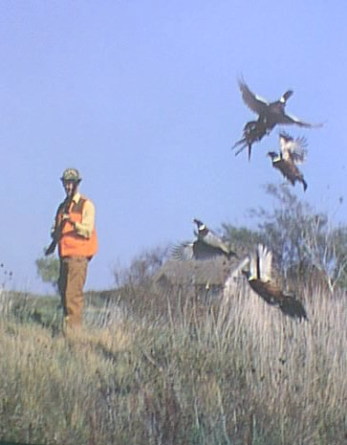
Marketing Philosophies
Ready, Aim, Aim, Aim, Aim, Aim, ………
Ready, Fire, Aim!
The man who insists on seeing with perfect clearness before he decides, never decides.
Henri-Frédéric Amiel

Slide 24
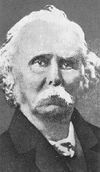
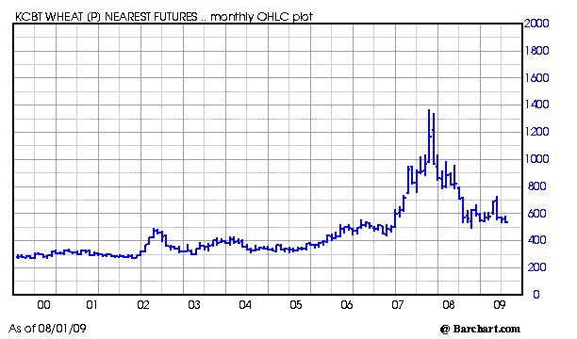
How high? How long?
Notes:
“…as a general rule, the shorter the period we are considering, the greater…the influence of demand on value; and the longer the period,
the more important will be the cost of production on value.” --Principles of Economics, Sir Alfred Marshall (1890)
Prices will fall back to their cost of production.

Slide 25
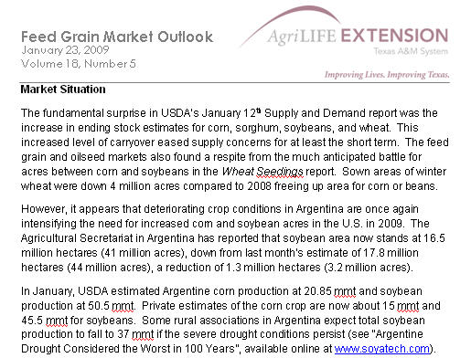
Outlook Reports Available
JMWelch@ag.tamu.edu

Slide 26
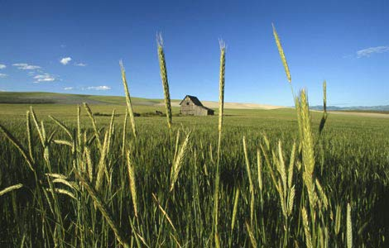
Mark Welch, Economist—Grain Marketing
JMWelch@ag.tamu.edu
(979)845-8011
http://agecoext.tamu.edu/index.html
Notes:
Outreach
Go to extension web page, then resources, then market outlook to see cotton, grain, and livestock updates.

